Slide 1

Music & Mental Health
Presented by:
Angie Oehler

Slide 2
Questions to Address
Why this topic?
How was the data cleaned?
How does listening to favorite genre affect a patient’s mood?
How are the genres distributed across age groups?
What role does age play in how music affects a person’s mood?
What correlations were found?
Is there a relationship between being a composer/musician and a person’s mental health scores?
How are the disorders distributed according to a patient’s favorite genre?
How are the disorders distributed by age group?
Are we able to make music therapy recommendations based on a patient's age and favorite genre?

Slide 3
Business Problem & History
Music therapy is effective treatment for some mental health disorders
Improve patient outcomes
Almost 20% of adults experience a mental health condition
About 5% of adults diagnosed with a serious mental health condition
Mental health disorders may affect anyone and generally result from a combination of factors
Music positively impacts those who experience depression and anxiety disorders

Slide 4
The Data
Survey Details
Background
Musical genres
Available options are:
Never
Rarely
Sometimes
Very frequently
Mental health – they ranked how often they experience up to five designated mental health conditions on a scale of 0 – 10:
Person’s age
Streaming service of choice
Effect listening to music has on their mental health disorder.
Disorder | Mean Score
Anxiety | 5.8
Depression | 4.8
Insomnia | 3.7
OCD | 2.6

Slide 5

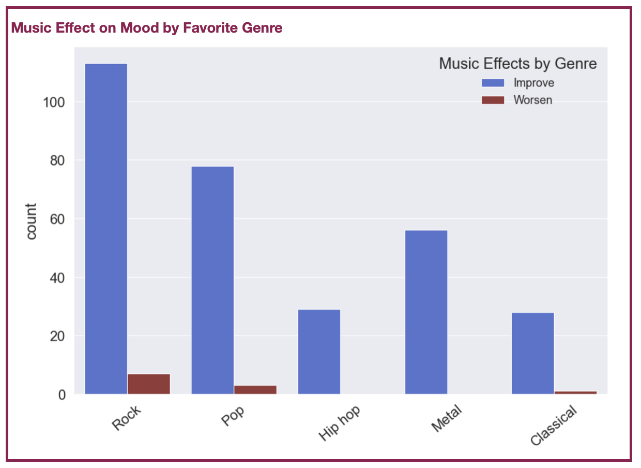
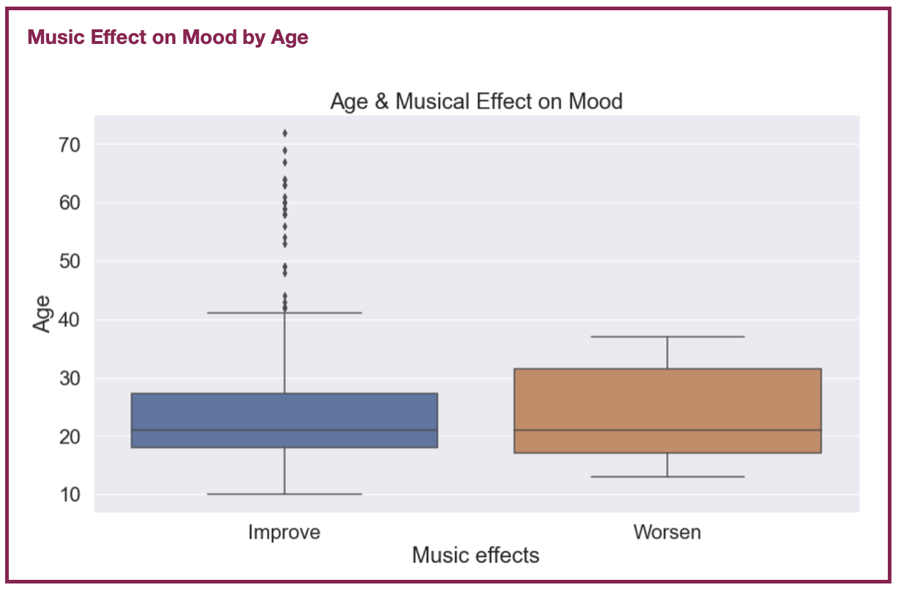




Methods & Analysis

Slide 6
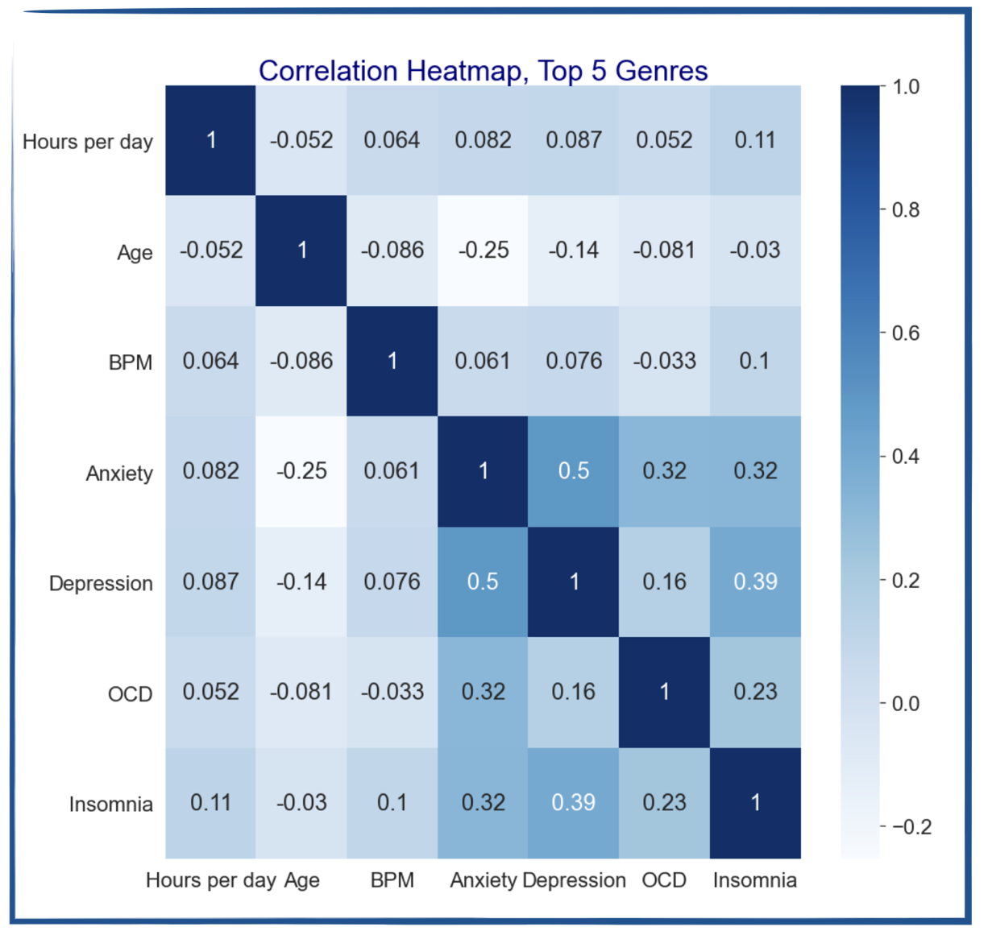

Analysis, cont.

Slide 7
Analysis, cont.
Mental Health Means Comparisons
Disorder | Musician | Non-Musician
Anxiety | 6.3 | 5.97
Depression | 5.0 | 4.9
Insomnia | 3.7 | 3.7
OCD | 2.8 | 2.7
Disorder | Composer | Non-Composer
Anxiety | 6.1 | 6.1
Depression | 5.3 | 4.9
Insomnia | 4.4 | 3.5
OCD | 2.8 | 2.7

Slide 8
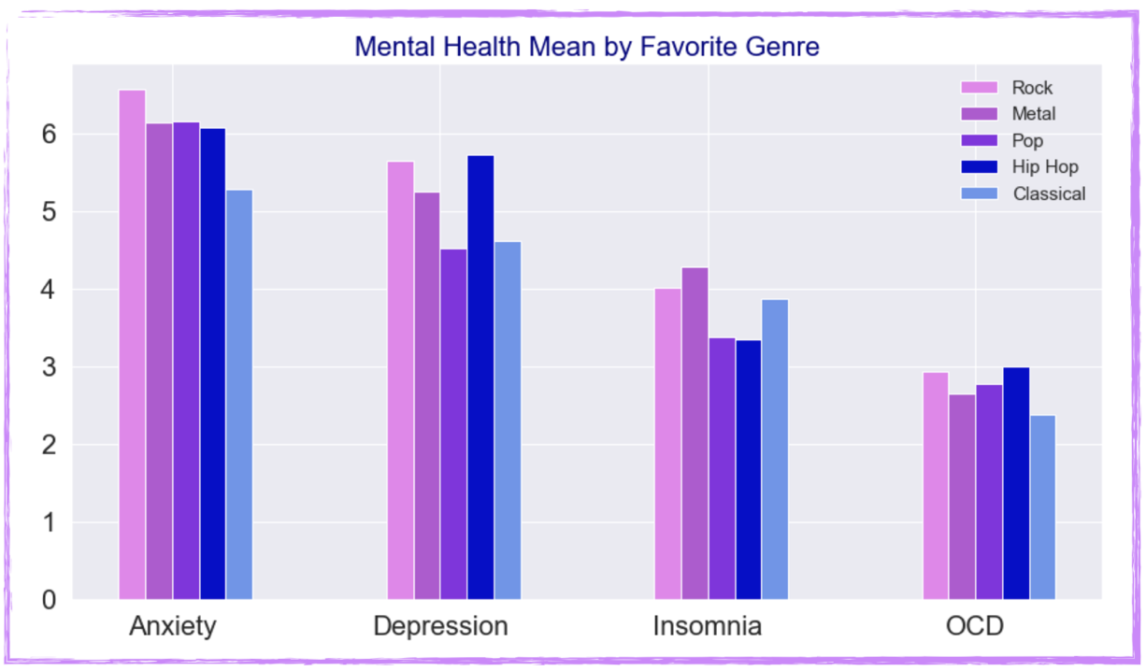
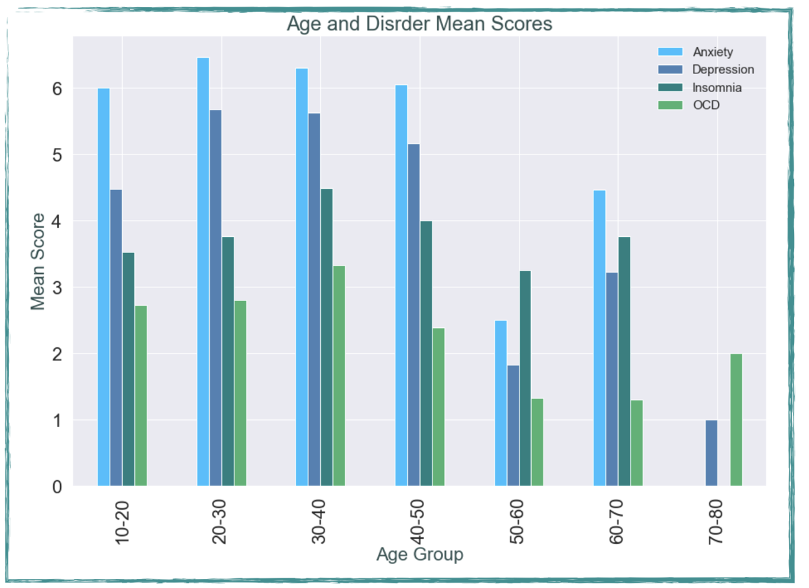
Analysis, cont.

Slide 9
Conclusions
Design affective music therapy program through examination of a patient’s:
Mental health disorder
Favorite genre
Age
Predict benefits of other music genres

Slide 10
Assumptions & Limitations
Assumptions
Limitations
Self identified disorders
No guarantee of diagnosis
Assume respondents have the identified disorder
No great challenges or limitations
Smaller dataset
736 respondents
Did not prevent meaningful conclusions

Slide 11
Future Uses, Recommendations, & Ethics
Clinical setting for patients
Design an effective program
Recommendations
Expand study
Strengthen current observations and/or reveal new trends
Benefit from real patient data
No PII required
No privacy concerns
Ethics
No concerns with dataset
Patients needs must come first

Slide 12
THANK YOU

Slide 13
American Music Therapy Association. (2023). AMTA Official Definition of Music Therapy.
Retrieved from https://www.musictherapy.org/about/musictherapy/
Dvorak, A. L., Carvalho, S.; Rosey, C., Welch, J.; Wierman, A., Bernard, G., Steele, K.,
Silverman, M. J. (2021).
Music Therapy for Adults with Mental Health and Substance Use Conditions. Retrieved from https://www.musictherapy.org/assets/1/7/FactSheet_Music_Therapy_for_Adults_with_Mental_Health_a nd_Substance_Use_Conditions_2021.pdf
Rasgaitis, C. (2022). Music & Mental Health Survey Results. Retrieved from
https://www.kaggle.com/datasets/catherinerasgaitis/mxmh-survey-results/data

